Slide 1
Heart Attack Prediction
By Santanu Ghosh, Jayanta Das & Arijit Mukherjee

Slide 2
Content
Heart Attack Chances Prediction Model
Age
Types of Chest Pain
Gender
Sex
Tresbps
Cholesterol
FBS
RestECG
Thalach
Exang
Oldpeak
Slope
Ca
Thal
Target

Slide 3
Introduction:
14 Medical Parameters have been used for the prediction.
The Effective heart disease prediction system(EHDPS) predicts the likelihood of patients getting heart disease and enables significant knowledge, e.g., relationships between medical factors related to heart disease and patterns, to be established

Slide 4
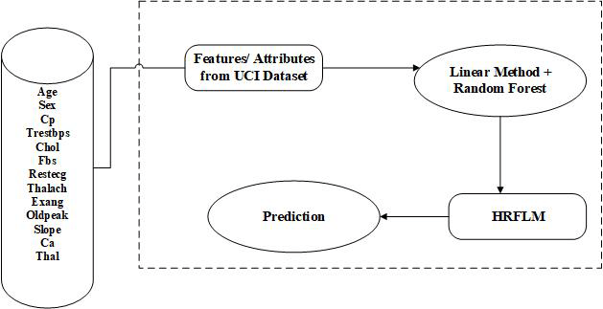
objective
To build a model to predict the chances of having heart attack among people with Certain predictive features in a specific Dataset.

Slide 5
Factors related to heart attack
Age
Sex
Chest pain
Tresbps
Cholesterol
Fasting Blood Sugar
RestECG
Thalach
Exang
Old peak
Slope
Ca
Thalassemia

Slide 6
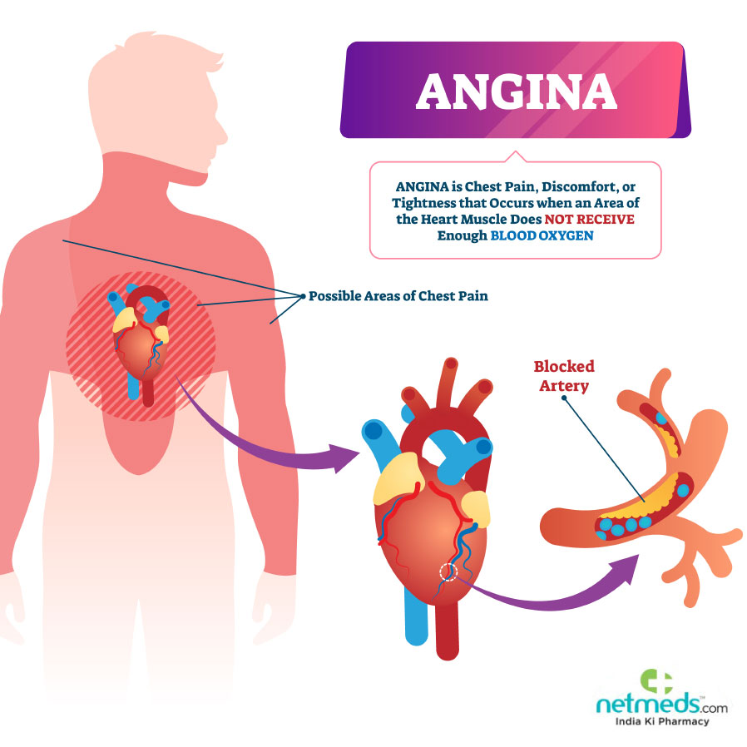
Types of Chest Pain
Typical Angina
Atypical angina
Non-Anginal-Chest-pain
Asymptomatic Chest pain

Slide 7
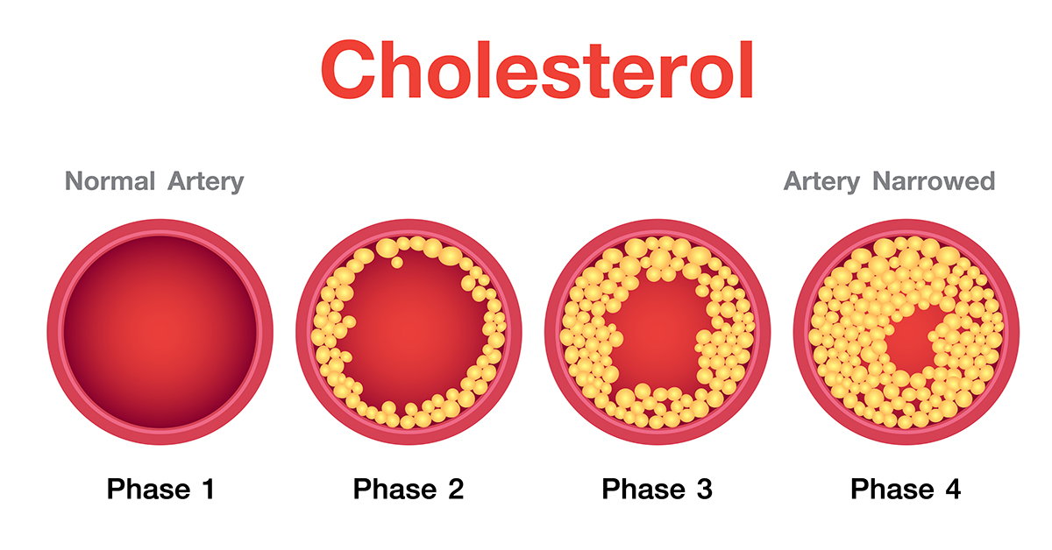
:
Cholesterol Is an important ingredient in our body which produces fatty cells in our body.
There are two types of cholesterol :
Good Cholesterol (H.D.L)
Bad Cholesterol(L.D.L)

Slide 8
Fasting blood sugar Normal Range:100-125 mg/dl
Level | mg/dl | mmol/dl | Risk | Suggested action
Dangerous high | 315 | 11 | Very High | Seek immediate medical attention
High | 280 | 15.6 | High | Seek medical attention
High | 250 | 13.7 | High | Seek medical attention
High | 198 | 11 | High | Seek medical attention
Borderline | 180 | 10 | Medium | Consult your doctor
Borderline | 150 | 8.2 | Medium | Consult your doctor
Borderline | 120 | 7 | Medium | Consult your doctor
Normal | 108 | 6 | No Risk | No action Needed
Normal | 72 | 4 | No Risk | No action Needed
Low | 70 | 3.9 | Medium | Consult your doctor
Dangerous Low | 50 | 2.8 | High | Seek medical attention

Slide 9
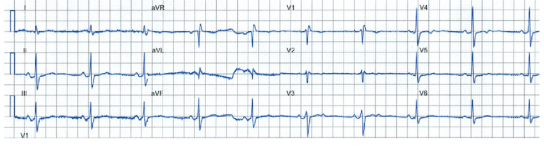
Rest ECG Maximum heart rate archived by exercise

Slide 10
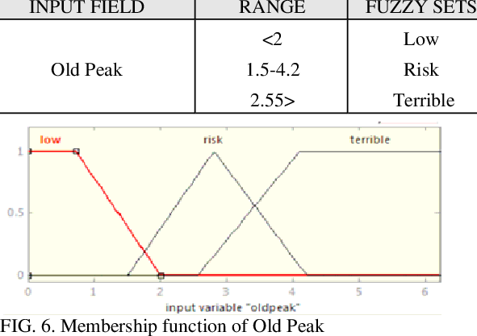
Old peak
Exercise related to rest(oldpeak) the slope of the peak. Exercise ST segment(slope) no of major vessel colored by fluoroscopy and Thalassemia

Slide 11
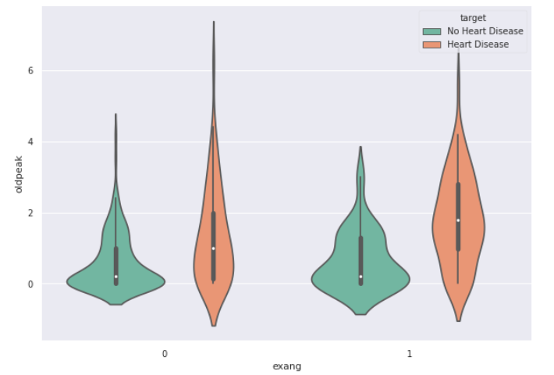
Exang
What is Exang ?
Plot of Exang
Exercise induced Angina
Stable angina is usually triggered by physical activity
Example:
when you climb stairs ,exercise or work your heart demands more but
Narrow arteries slow down the blood flow

Slide 12
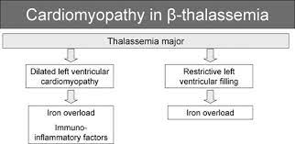
Thalassemia
It is a blood disorder heart cannot pump enough blood

Slide 13
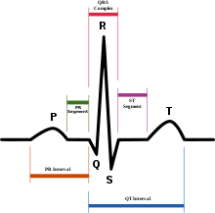
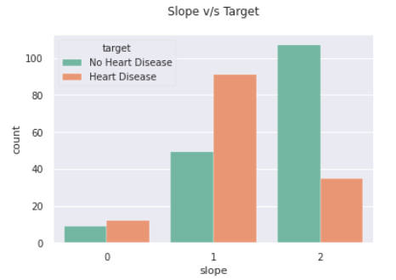
Slope
The ST segment merge due to excessive exercise.
The ST segment shift relative to Exercise induced increments in heart rate
The Heart Rate slope expressed as a more accurate E.C.G criterion for diagnosing significant of Arteries

Slide 14
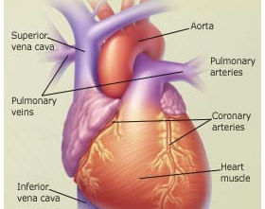
Coronary Artery
Major Vessels of Heart aorta
There are four types of Coronary Arteries
Superior Venacava
Inferior venacava
Pulmonary ven and arteries
Coronary Arteries

